Slide 1
Empowering Sustainable Mobility
“Addressing Range Anxiety in Electric Vehicles by charging of EVs without compromising styling”

Slide 2






CONTENTS
Improved Lithium-Ion Battery
Power bank
Design Optimization
Compact Solar Panels
Better Dynamo usage
Piezoelectric tyres
TEAM: Punishers

Slide 3

POWER BANK
The evolution of portable charging solutions for electric bikes is a critical driver in the adoption of electric two-wheelers. These solutions offer the convenience and flexibility that riders demand, making the transition to electric mobility seamless and user friendly.
TEAM: Punishers

Slide 4

POWER BANK
Having a high energy density, lithium-ion batteries can improve the mileage range of electric vehicles.
Having a power bank as a backup battery of electric vehicles is a cost effective and feasible method to increase the range of the vehicles.
TEAM: Punishers

Slide 5
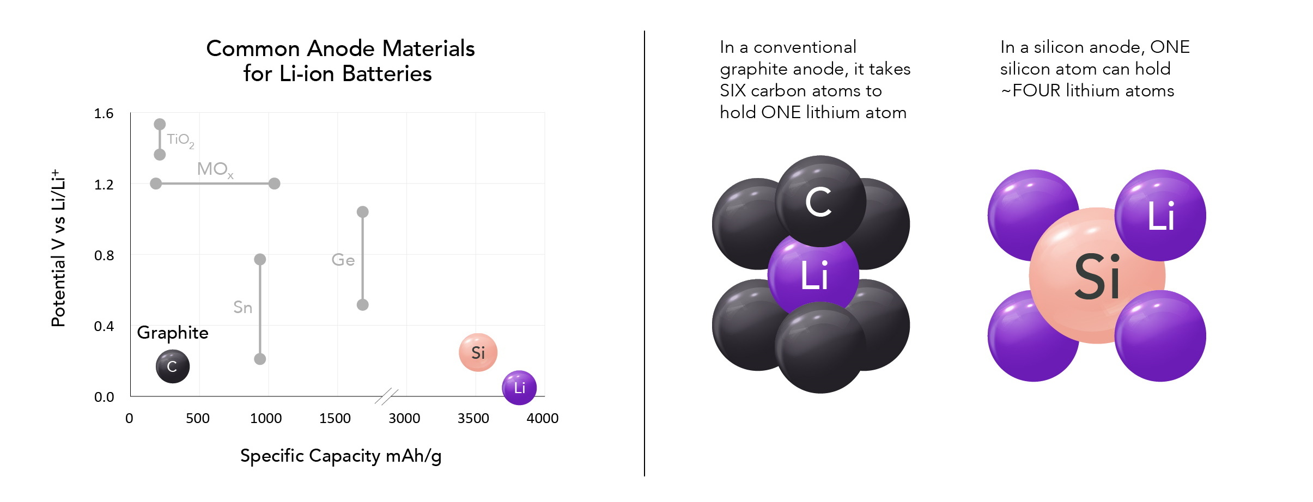
INCREASING CAPACITY OF LITHIUM-ION BATTERY
By use of Silicon Anode:- This increases the higher energy retention of the battery by 70%.However, with 300% increase in volume.
TEAM: Punishers

Slide 6
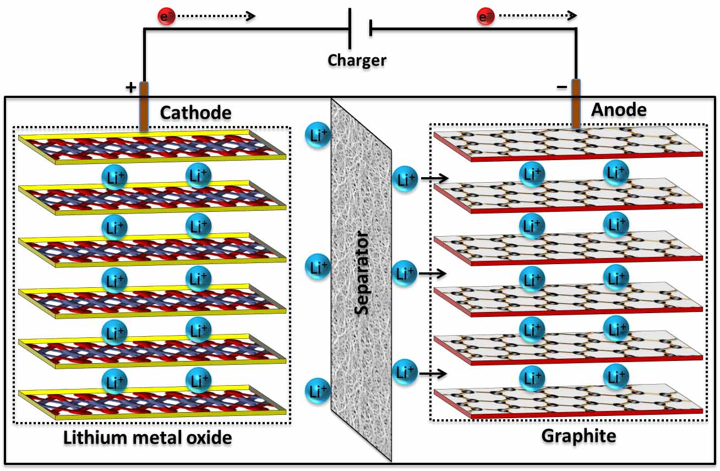
INCREASING CAPACITY OF LITHIUM-ION BATTERY
By use of Graphite coated anodes can increase battery capacity by 1% and upto 20% using recovery cycle involving non uniform Li-ion distribution is formed under shallow cycling and leads to capacity loss. It can be restored.
TEAM: Punishers

Slide 7
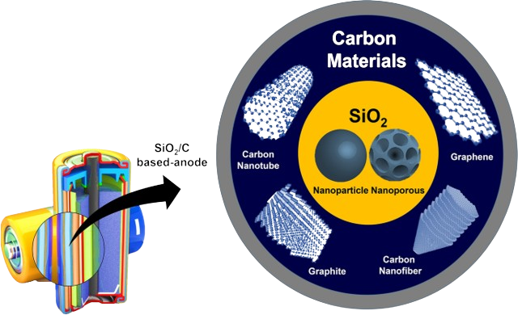
INCREASING CAPACITY OF LITHIUM-ION BATTERY
By using Silicon dioxide coated with carbon for anode material due to its expansion volume which is lowest among all strategies, that is only 100%
TEAM: Punishers

Slide 8

BY use of dynamos to recharge battery on the go
Conversion of the Kinetic Energy of the rotation of the motor into electrical energy recharging the battery by the use of electric generators known as “dynamos” coupled to the motor assembly. This is based on Faraday's law of electromagnetic induction. Where changing in the magnetic flux due to rotation of the dynamo induces an emf which can then be used to store electric energy in the battery thereby recharging it.
TEAM: Punishers

Slide 9
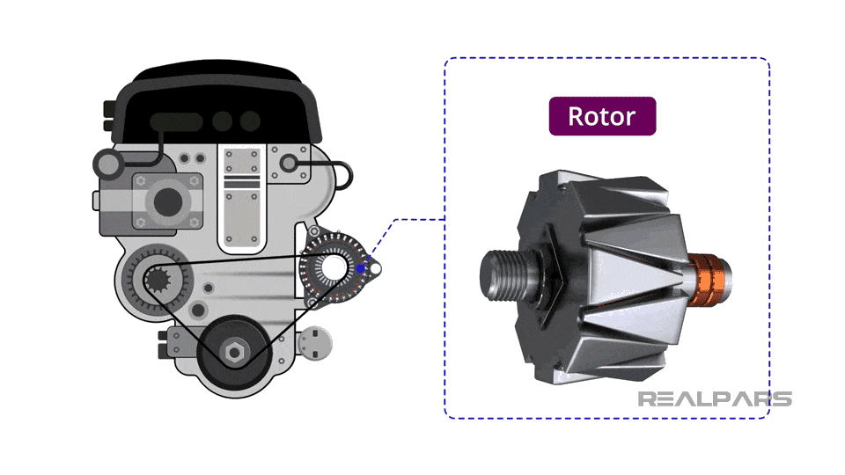
BY use of dynamos to recharge battery on the go
We can use three dynamos instead of just one, that is one in the front wheel, one in the rear and the third one coupled to the motor to maximize the recharging rate in 2 wheelers. Although this is not yet a cost-effective method for the low-end vehicles, we can surely implement it in the heavy-duty vehicles or sports bikes and test the usage in the real world. This would help us to gain valuable insights to implement the same for low-end vehicles in the future.
TEAM: Punishers

Slide 10
OPTIMIZING DESIGN
By reducing weight of the vehicle by increasing the use of lightweight plastic parts for the tank body , below the seat area, etc.
By introducing features like power saving to limit rpm of the motor once power levels reach below a certain value using electronic components by reducing power input to the motor.
TEAM: Punishers

Slide 11

OPTIMIZING DESIGN
By using more aerodynamic design to reduce drag coefficient and thereby reducing load on the motor and thus achieving lower power consumption.
Design and optimization of a hybrid battery thermal management system for electric vehicles based on a surrogate model.
TEAM: Punishers

Slide 12
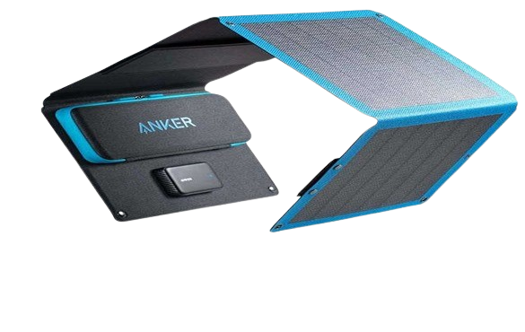
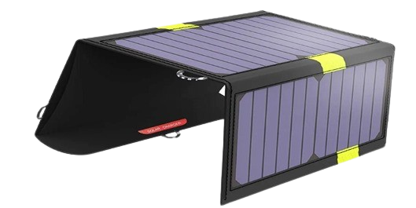
FOLDABLE SOLAR CHARGER
An idea to incorporate the utilization of solar panels but at the same time not compromising the design aesthetics of the vehicle is to add a compartment of solar-box
This solar-box is a small foldable accessory housed in the inner compartment of the vehicle which can be removed from the compartment as per requirement, open it and mount it on a stand of the vehicle which helps to charge the battery to which it would be connected wired (kind of like a plug point).
TEAM: Punishers

Slide 13

FOLDABLE SOLAR CHARGER
This solar-box is a small foldable accessory housed in the inner compartment of the vehicle which can be removed from the compartment as per requirement, open it and mount it on a stand of the vehicle which helps to charge the battery to which it would be connected wired (kind of like a plug point).
TEAM: Punishers

Slide 14
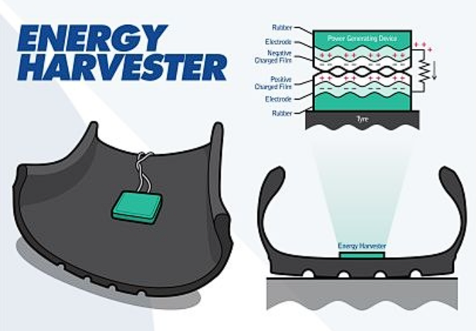
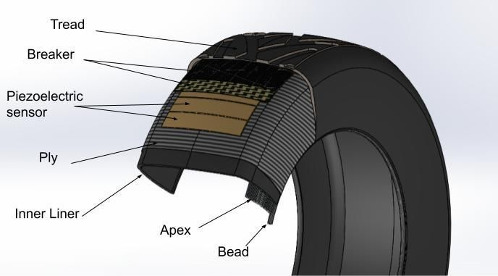
PIEZOELECTRIC TYRES
Using the phenomenon of piezoelectric effect enables the conversion of mechanical energy, resulting from the contact between a vehicle's wheel and the road, into electrical energy.
TEAM: Punishers

Slide 15
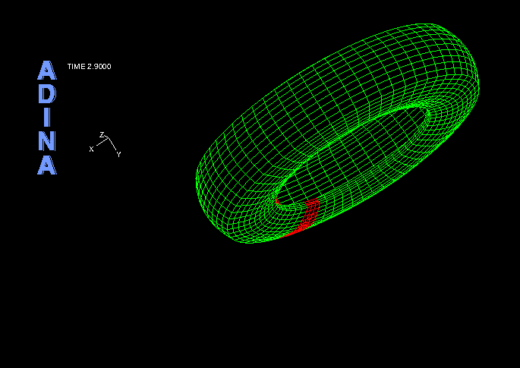
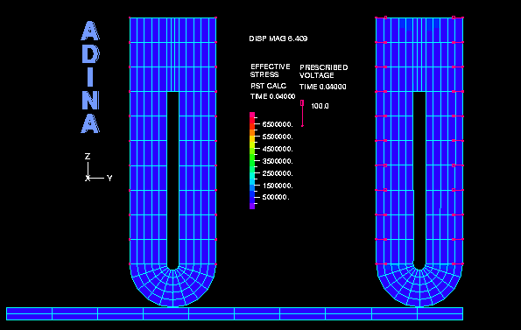
PIEZOELECTRIC TYRES
Piezoelectricity refers to the accumulation of electric charge in specific solid materials, such as ceramics, human bone, and DNA, in response to mechanical stress. To achieve this, piezoelectric patches are strategically positioned within the wheel rim. When these patches come into contact with the road and are subjected to the weight of the vehicle, electricity is generated.
TEAM: Punishers

Slide 16
SUMMARy
From the proposed solutions in this presentation, we aim to improve the range of existing electric vehicles without compromising most of the styling and at the same time reducing the damage to the environment.
TEAM: Punishers

Slide 17



TEAM PUNISHERS
Durvankur Pradip Diwadkar
Deep Samanta
Akshit Kushwaha
TEAM: Punishers
Takuma Hayashi​
Mirjam Nilsson​
President
Chief Executive Officer

Slide 18
THANK YOU
~TEAM PUNISHERS
TEAM: Punishers

